Slide 1
Employee Data Analysis using Excel
STUDENT NAME : MALAVIKASREE.S
REGISTER NO : 312209310
DEPARTMENT : BCOM(GENERAL)COMMERCE
COLLEGE : ADARSH COLLEGE FOR WOMENS

Slide 2
PROJECT TITLE
Employee Performance Analysis using Excel

Slide 3


AGENDA
Problem Statement
Project Overview
End Users
Our Solution and Proposition
Dataset Description
Modelling Approach
Results and Discussion
Conclusion
3/21/2024 Annual Review

Slide 4

PROBLEM STATEMENT
To analyse and optimize the performance of the employees by evaluating the key metrics such as employee ld, employee status,employee level, performance level etc.The analysis aims to identify the employees with greater efficiencies

Slide 5

PROJECT OVERVIEW
The prime objective is to create an employee performance analysis using excel with the help of variousfunctions such as conditional formatting, pivot table creation,chart etc..

Slide 6

WHO ARE THE END USERS?
Employers
Employee
Organisation

Slide 7

OUR SOLUTION AND ITS VALUE PROPOSITION
Filtering : To find the missing data
Chart : To get an graphical representation
Pivot table :To summarize the data
Conditional technique :Used to ldentify the missing data

Slide 8
Dataset Description
Employee dataset:Kaggle
Total:26Feature
Used:9 features
  Employee ld
  First name
  Last name
  Business unit
  Employee type
  GenderPerformance
  scoreCurrent
  employee rating

Slide 9

THE "WOW" IN OUR SOLUTION
Formula:=IFS(Z2>=5,"VERY HIGH",Z2>=4,"HIGH",Z2>=3,"MEDIUM",TRUE,"FALSE")
This formula ls used to find the performance level of the employees which is derived as “medium,low and high” to get an graphical representation of the employees performance.
CONDITIONAL FORMATTING: The conditional formatting is used to identify the missing data in a cell, highlight the missing cels and also to remove the missing cell .
3/21/2024 Annual Review

Slide 10
MODELLING
DATA SCREENING: Downloaded an employee dataset from Kaggle and saved the dataset in an folder then inserted the same in excel.
DATA CLEANING: Using conditional formatting, non-binary identified and removed the missing data and selected 5 data, from these data are name, gender etc.
DATA FORMULATING: Using “IFS” condition created an column of performance level using data from current employee working given an output as medium, low, high.
PIVOT TABLE CREATION: Select pivot table from insert and as pivot table is enabled, now select the required data. As pivot table is now created you can also create pivot table through Queries and Connection.
GRAPHICAL REPRESENTATION: After creating an pivot table select the pivot table and go to insert icon and select recommendation chart and an visual representation is created.

Slide 11
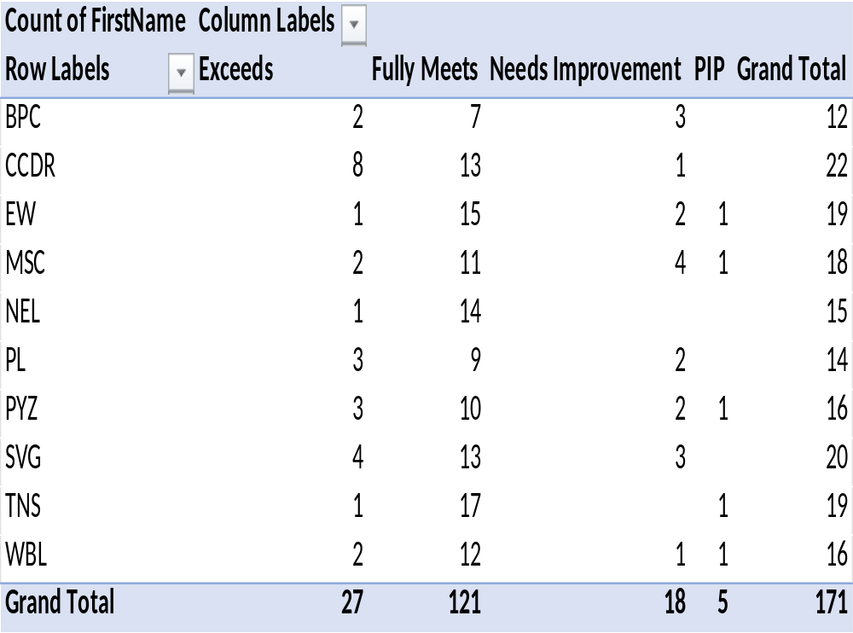
RESULTS

Slide 12
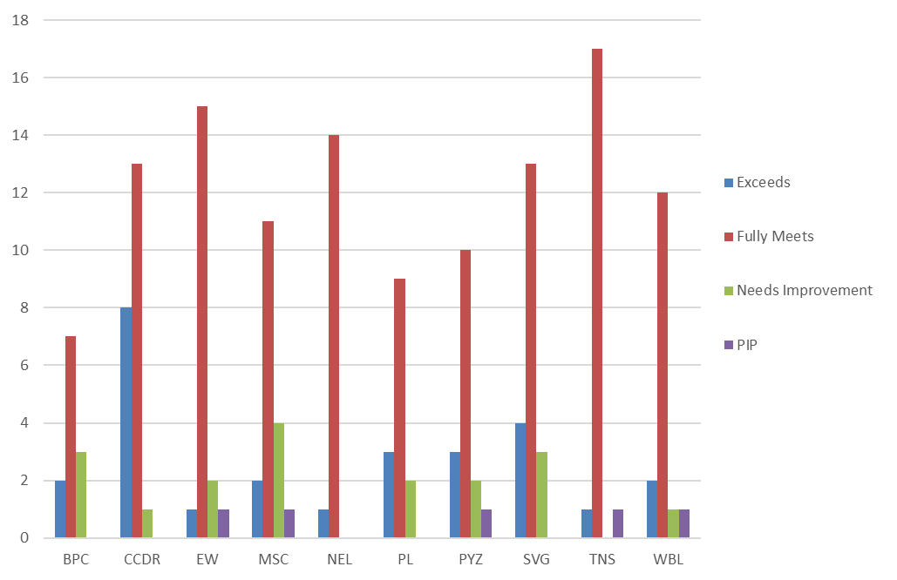
RESULTS

Slide 13
conclusion
The end output is created as employee performance analyses using various functions such as pivot table, graph etc. This helps to easily analyse the data. This performance analysis is used to find the employees with greater efficiency.

